Slide 1
CS 331
Operator Overloading
MD Romael Haque

Slide 2
Operator Overloading
As we have seen, copy constructors are designed to solve problems that arise when an object containing a pointer is initialized with the data of another object of the same class using memberwise assignment.
Similar problems arise in object assignment.

Slide 3
Operator Overloading
For example, with the NumberArray class of the previous section, we may have a program that has defined two objects of that class:
NumberArray first(3, 10.5);
NumberArray second(5, 20.5);
first = second;
If we want to set the first object to exactly the same value as the second.
At this point, C++ will once again perform a memberwise copy from the second to the first object, leaving pointers in both objects pointing to the same memory.

Slide 4
Operator Overloading
Because the default object assignment encounters the same problem as the default copy constructor, we might think that a programmer-defined copy constructor can be used to solve the problem caused by the default assignment, but this is not so.
Copy constructors only come into play when an object is being initialized at creation time.
In particular, copy constructors are not called in an assignment.

Slide 5
Operator Overloading
To see the difference between initialization and assignment, suppose that the object first has already been created.
Then the statement -
NumberArray second = first; // copy constructor called
which creates second and initializes it with the value of first, is an initialization and causes the copy constructor to be called to perform the initialization.
However, the statement –
second = first; // copy constructor not called
which assumes that both objects have previously been created, is an assignment, and therefore no constructor is invoked.

Slide 6
Operator Overloading
To address the problems that result from memberwise assignment of objects, we need to modify the behavior of the assignment operator so that it does something other than memberwise assignment when it is applied to objects of classes that have pointer members.
In effect we are supplying a different version of the assignment operator to be used for objects of that class.
In so doing, we say that we are overloading the assignment operator.

Slide 7
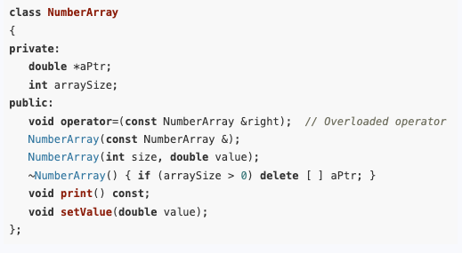
Operator Overloading
One way to overload the assignment operator for a given class is to define an operator function called operator= as a member function of the class

Slide 8
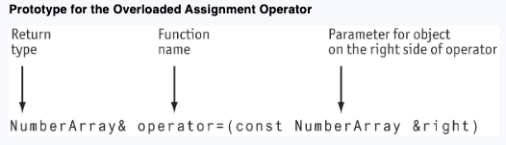
Operator Overloading
Let’s take a look at the function header, or prototype, before we look at how the operator function itself is implemented.

Slide 9
Operator Overloading
The name of the function is operator=.
Since the operator function is an instance member of a class, it can only be called through an object of the class.
The object of the class through which it is called is considered the left operand of the assignment operator, while the parameter passed to the function is considered the right operand of the assignment operator.

Slide 10
Operator Overloading
To illustrate, let us suppose that two objects, left and right, have been defined in a program
NumberArray left(3,10.5);
NumberArray right(5, 20.5);
To assign the value of right to left, we call the member function operator= through the left object, and pass it the right object as parameter:
left.operator=(right);
While you can call operator functions this way, the compiler will also let you use the more conventional notation
left = right;

Slide 11
Operator Overloading
Parameters to operator functions do not have to be passed by reference, nor do they have to be declared const.
In the example, we have used a reference parameter for efficiency reasons:
Reference parameters avoid the overhead of copying the object being passed as parameter.
The const is used to protect the parameter from change.

Slide 12
Implementation of the Class Assignment Operator
Let us now consider the implementation of assignment operator. First notice that there is no need to do any copying if a statement such as x = x;
It is resulting in an object being assigned to itself.
We can test for this possibility by checking that the address this of the object on the left side of the assignment is different from the address of the object on the right side like this:
if(this != &right) { /* copy the object …*/ }

Slide 13
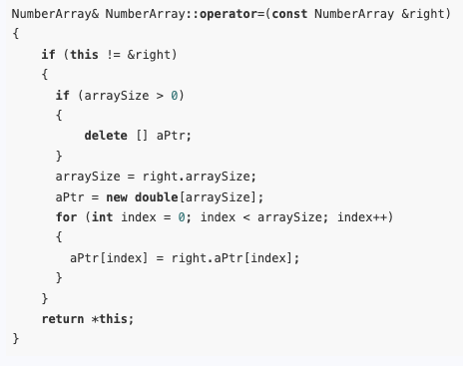
Implementation of the Class Assignment Operator
The assignment operator function starts by deleting the memory allocated to pointers in the object being assigned to.
After that, it makes a copy of the other object in much the same way as the copy constructor for the class.
The last act of the function is to return (by reference) the object *this on the left side of the assignment.

Slide 14
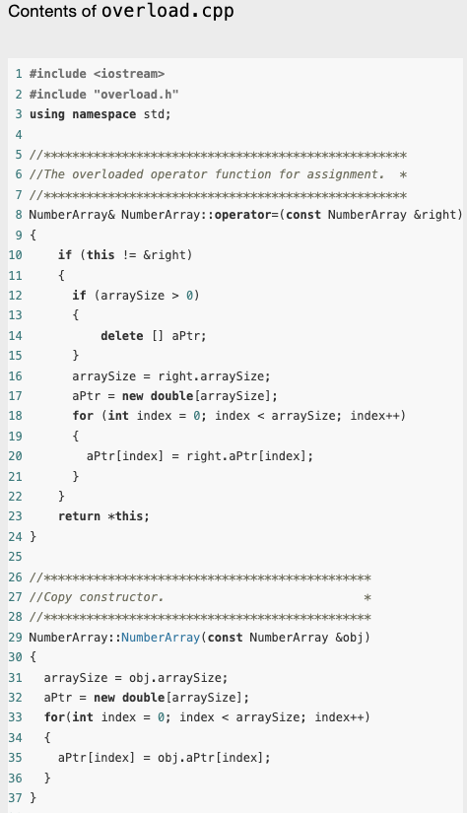
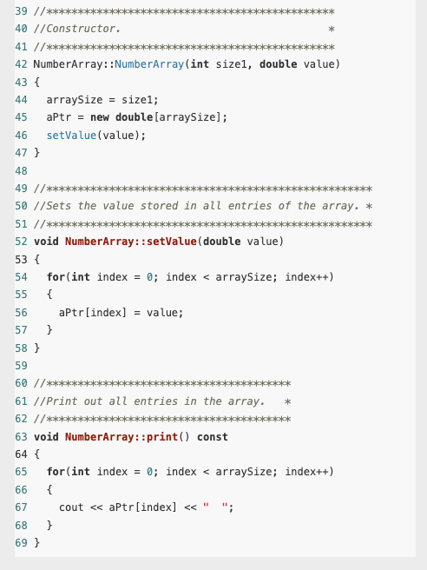
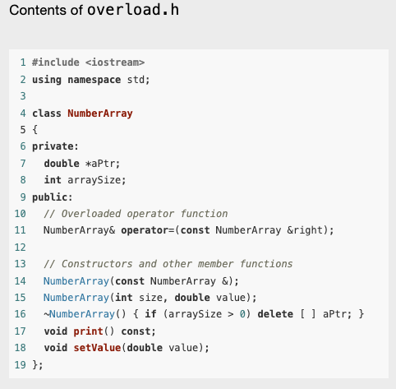
Example

Slide 15
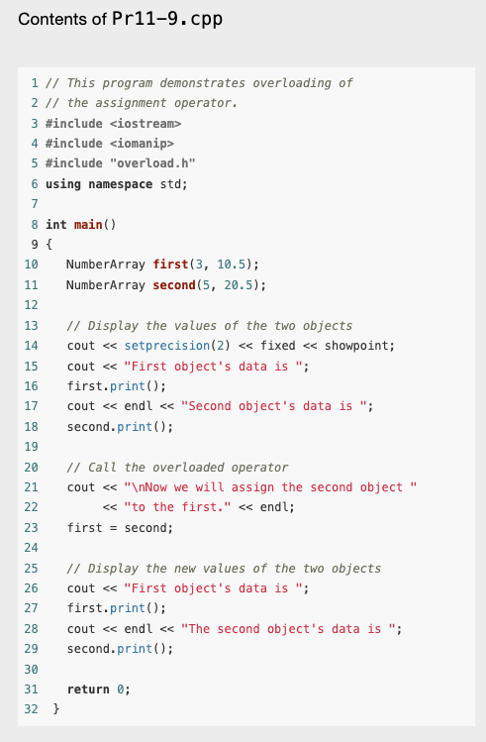
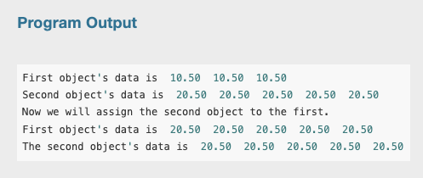
Example

Slide 16
Overloading Other Operators
C++ allows the programmer to overload other operators besides assignment.
There are many times when it is natural to overload some of C++’s built-in operators to make them work with classes that the programmer has defined
Let’s look at an example

Slide 17
Overloading Other Operators
Assume that a class named Date exists and that objects of the Date class hold the day, month, and year in member variables.
Suppose the Date class has a member function named add. The add member function adds a number of days to the date and adjusts the member variables if the date goes to another month or year.
For example, the following statement adds five days to the date stored in the today object:
today.add(5);

Slide 18
Overloading Other Operators
Although it might be obvious that the statement is adding five days to the date stored in today, the use of an operator might be more intuitive.
For example, look at the following statement:
today += 5;
This statement uses the standard += operator to add 5 to today.
This behavior does not happen automatically, however.
The += operator must be overloaded for this action to occur.

Slide 19
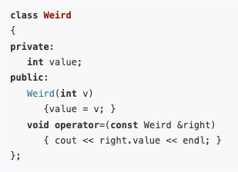


General Issues of Operator Overloading
First, you can change an operator’s entire meaning, if that’s what you wish to do.
There is nothing to prevent you from changing the = symbol from an assignment operator to a “display” operator.
Although the operator= function overloads the assignment operator, the function doesn’t perform an assignment.
All the overloaded operator does is display the contents of right.value.

Slide 20
General Issues of Operator Overloading
Another operator overloading issue is that you cannot change the number of operands taken by an operator.
The = symbol must always be a binary operator.
Likewise, ++ and −− must always be unary operators.

Slide 21
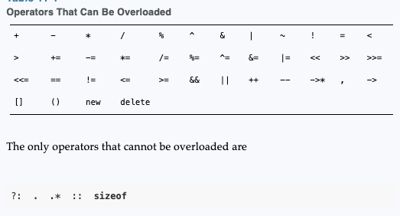
General Issues of Operator Overloading
The last issue is that although you may overload most of the C++ operators, you cannot overload all of them

Slide 22
Approaches to Operator Overloading
There are two approaches you can take to overload an operator:
1. Make the overloaded operator a member function of the class.
This allows the operator function access to private members of the class.
It also allows the function to use the implicit this pointer parameter to access the calling object.
2. Make the overloaded member function a separate, stand-alone function.
When overloaded in this manner, the operator function must be declared a friend of the class to have access to the private members of the class.

Slide 23
Approaches to Operator Overloading
Some operators, such as the stream input and output operators >> and <<, must be overloaded as stand-alone functions.
Other operators may be overloaded either as member functions or stand-alone functions.

Slide 24
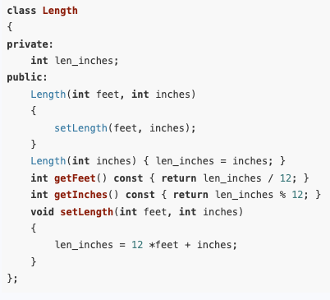
Approaches to Operator Overloading
Consider a class designed to represent length measurements.
The class internally represents the length of an item in inches but allows its clients to specify measurements in feet and inches via a setLength() function.
The class also provides member functions getFeet() and getInches() to allow the feet and inch components of a measurement to be separately retrieved.

Slide 25
Overloading the Arithmetic and Relational Operators
Clients of the class must be able to add and subtract measurements.
In addition, they should be able to compare two measurements to see if they are equal or if one of them is less or greater than the other.
We can provide all these capabilities by overloading the operators +, −, <, and == as stand-alone functions.

Slide 26
Overloading the Arithmetic and Relational Operators
We start by adding the following declarations to the Length class:
friend Length operator+(Length a, Length b);
friend Length operator−(Length a, Length b);
friend bool operator<(Length a, Length b);
friend bool operator==(Length a, Length b);
To see how we arrive at these declarations, consider the addition and less-than operators.
Addition needs to take two Length objects a and b as parameters and produce a third Length object that is the sum of a and b.
Similarly, the less-than operator needs to take two Length objects as parameters and return a Boolean value.

Slide 27
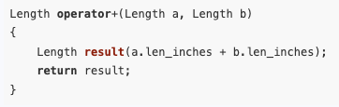

Overloading the Arithmetic and Relational Operators
To see how to write the code that implements these functions, consider again the addition operator.
Given two input parameters a and b, it needs to return a Length object whose len_inches member is the sum of the len_inches members of a and b.
Or

Slide 28
Overloading the Arithmetic and Relational Operators
We can reason in a similar manner to work out the definitions of the operator functions −, <, and ==. Here
Let’s look at a complete example in the next slide -

Slide 29
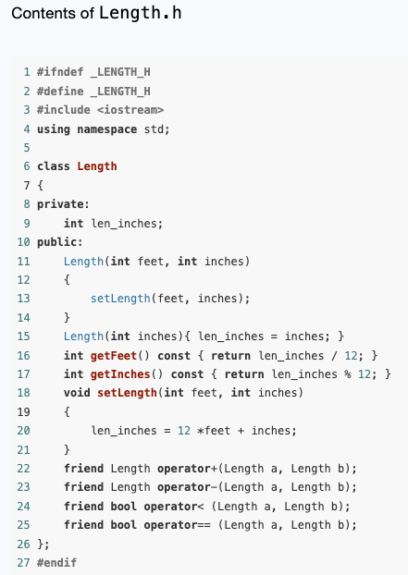
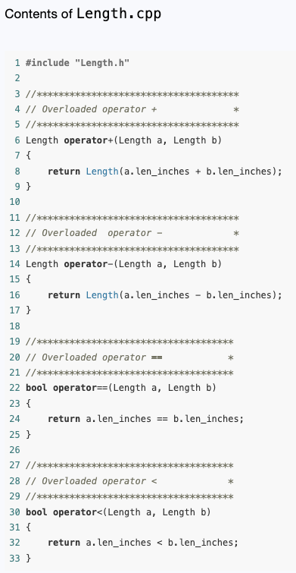
Example

Slide 30
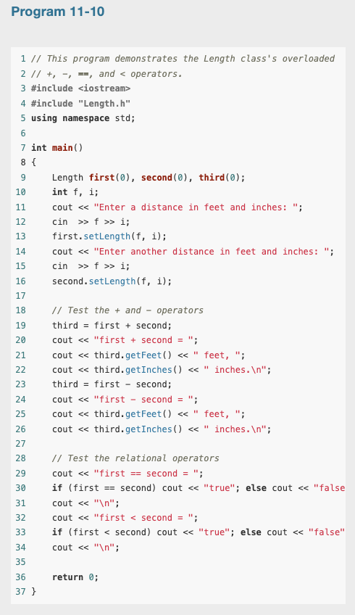
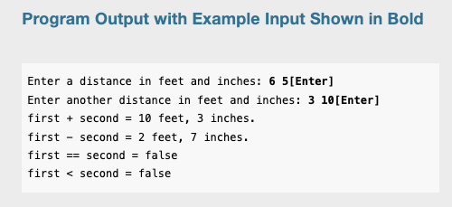
Example

Slide 31
Choosing Between Stand-Alone and Member-Function Operators
Given the stand-alone overloads we have written -
Length a(4, 2), b(1, 8), c(0);
c = a + b;
It is interpreted by the compiler as being
Length a(4, 2), b(1, 8), c(0);
c = operator+(a, b);
The compiler allows the programmer to use the friendly infix notation.
Internally, however, it sees the operator as just an ordinary function whose name is operator+.

Slide 32
Choosing Between Stand-Alone and Member-Function Operators
This has an implication that is not immediately obvious.
The statement: c = 2 + a;
Is equivalent to c = operator+(2, b);
Both of these statements compile and execute correctly because the convert constructor of the Length class is able to create a Length object out of the integer parameter 2.
You will learn about convert constructors later.

Slide 33
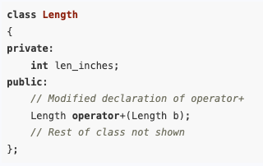
Choosing Between Stand-Alone and Member-Function Operators
We could just as easily have overloaded the arithmetic and relational operators as member functions.
Here is how to do so for the addition operator.
First, modify the in-class declaration to make the operator a member function:

Slide 34
Choosing Between Stand-Alone and Member-Function Operators
Notice that the operator is now declared as taking a single operator of type Length.
This is because as a member function, the operator is automatically passed a Length object through the implicit parameter this.

Slide 35
Choosing Between Stand-Alone and Member-Function Operators
When we write –
Length a(4, 2), b(1, 8), c(0);
c = a + b;
The compiler sees this as
Length a(4, 2), b(1, 8), c(0);
c = a.operator+(b);
When you write a + b, the left operand of the overloaded + operator becomes the object through which the member function is called, and the right operand becomes the explicit parameter.

Slide 36
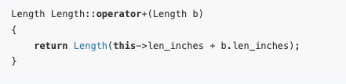
Choosing Between Stand-Alone and Member-Function Operators
With these changes, the body of the operator is written as follows:

Slide 37
Choosing Between Stand-Alone and Member-Function Operators
To sum up, the addition operator (as well as other arithmetic and relational operators) can be overloaded equally well as member functions or as stand-alone functions.
It is generally better to overload binary operators that take parameters of the same type as stand-alone functions.

Slide 38

Choosing Between Stand-Alone and Member-Function Operators
This is because, unlike stand-alone operator overloading, member-function overloading introduces an artificial distinction between the two parameters by making the left parameter implicit.
This allows convert constructors to apply to the right parameter but not to the left, creating situations where changing the order of parameters causes a compiler error in an otherwise correct program:

Slide 39
Overloading the Prefix ++ Operator
We want to overload the prefix operator for the Length class so that the expression ++b increments the object b by adding 1 inch to its length and returns the resulting object.
We overload this operator as a member function.
This makes its single parameter implicit, so the overloaded operator needs no parameters.

Slide 40
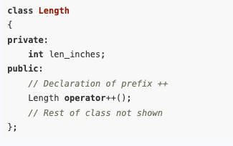
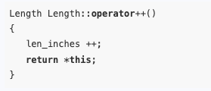
Overloading the Prefix ++ Operator
Here is the portion of the Length class that shows the operator declaration:
Here is the implementation of the operator—it increases the number of inches by 1 and returns the modified object:
Given this overload, the user-friendly notation ++b is equivalent to the call b.operator++().
Either notation may be used in your program.

Slide 41
Overloading the Postfix ++ Operator
The postfix increment operator b++ also increments the length of b but differs from the prefix version in that it returns the value that the object had prior to being incremented.
Overloading the postfix operator is only slightly different from overloading the prefix version.

Slide 42
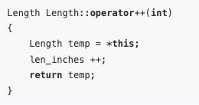
Overloading the Postfix ++ Operator
The first difference you will notice is that the function has a dummy parameter of type int that is never used in the body of the function.
This is a convention that tells the compiler that the increment operator is being overloaded in postfix mode.
The second difference is the use of a temporary local variable temp to capture the value of the object before it is incremented.
This value is saved and is later returned by the function.

Slide 43
Overloading the Stream Insertion and Extraction Operators
Overloading the stream insertion operator << is convenient because it allows values of objects to be converted into text and output to cout, to a file object, or to any object of a class that derives from ostream.

Slide 44


Overloading the Stream Insertion and Extraction Operators
In the presence of appropriate overloads, the statements
appear to the compiler as

Slide 45
Overloading the Stream Insertion and Extraction Operators
This equivalence has the following implications:
The overloaded operator << takes two parameters, the first of which is an ostream object and the second of which is an object of the class for which the operator is being overloaded. For the Length class, the prototype would be operator<<(ostream &strm, Length a)
To allow expressions (such as b + c) in the second parameter, the second parameter should be passed by value. The first parameter should be passed by reference because ostream parameters should never be passed by value because of efficiency and preservation.

Slide 46

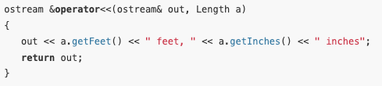
Overloading the Stream Insertion and Extraction Operators
In addition, the stream insertion operator should return its stream parameter so that several output expressions can be chained together, as in –
Putting all of this together, we see that the stream insertion operator should be written as

Slide 47
Overloading the Stream Insertion and Extraction Operators
Overloading the stream output operator is useful because it allows for the various fields of a complex class to be labeled during output.
For example, if you have a complex class with multiple fields, such as a Person class with fields for name, age, and address, overloading << lets you specify how each field should be displayed, including adding labels.
std::cout << person; // where person is an object of class Person
By overloading the << operator, the output might appear as:
Name: John Doe, Age: 30, Address: 123 Main St

Slide 48
Overloading the Stream Insertion and Extraction Operators
Overloading the stream input operator is similar, except that the class parameter signifying the object to be read into must be passed by reference. Thus, the header for the stream input operator looks like this:
istream &operator>>(istream &in, Length &a);

Slide 49
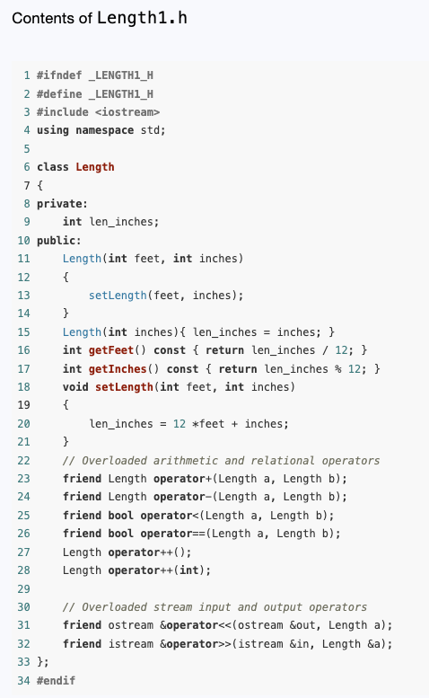
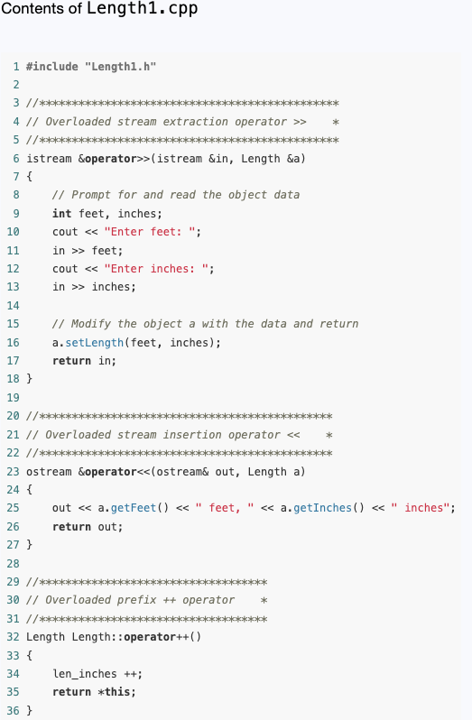
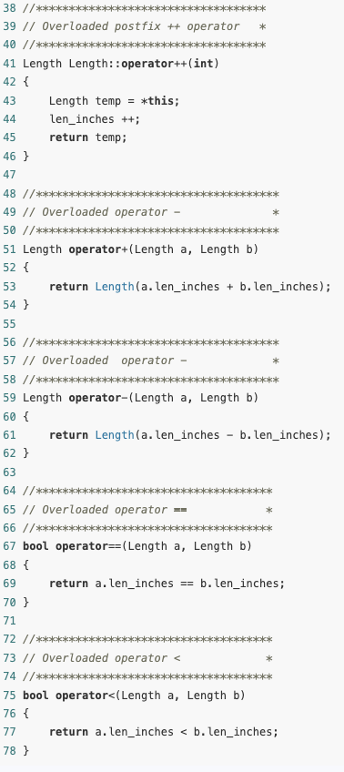

Slide 50
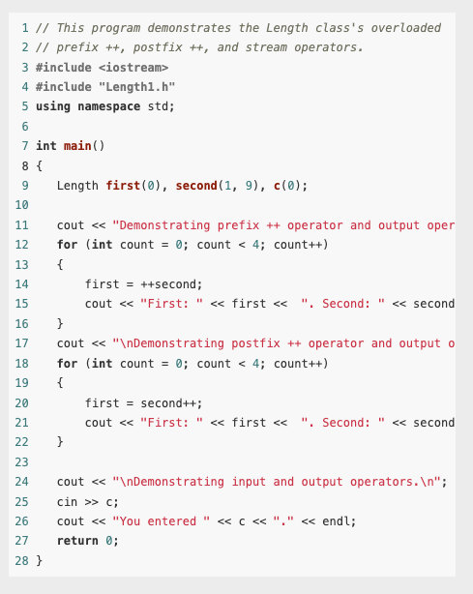
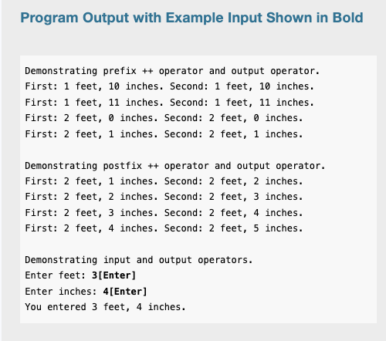

Slide 51
Overloading the [] Operator
Any C++ class can overload the array indexing operator [ ] to make its objects have array-like behavior.
To give a simple example, suppose we want to write a Name class to represent the full name of a person. For such a name object, we want name[1] to be the first name and name[2] to be the last name.
Furthermore, we want an attempt to index such an object with any integer other than 1 and 2 to terminate the program with an error message.

Slide 52
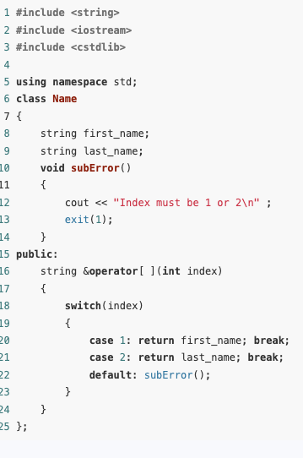
Example
Notice that the operator [ ] function takes an int parameter and returns a reference to a string variable.
If name is an object of this class and k is an integer, the call name.operator[ ](k) will be equivalent to name[k].
Basically, name[1] will return a reference to the member variable first_name, and name[2] will return a reference to last_name.

Slide 53
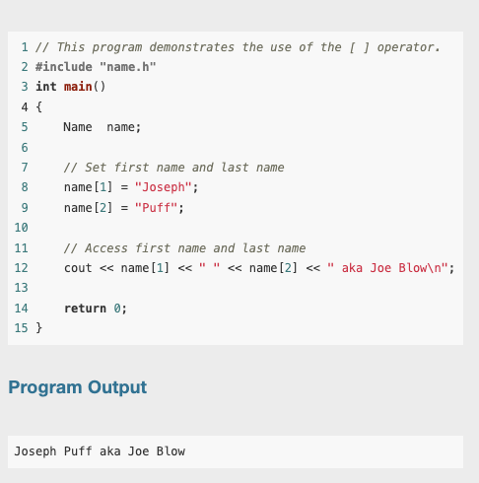
Example

